Slide 1
GUI Design & Aesthetics

Slide 2
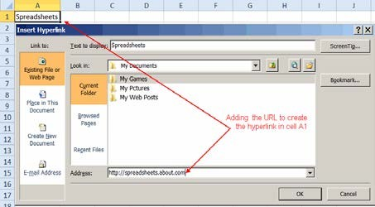
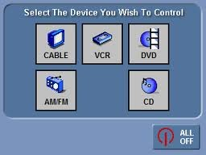

GUI: Graphic User Interface
The interface through which a user operates a program or an application or an device
Consists of individual or group of ICONS, buttons, scroll bars, menus, widgets, boxes, status lamps, labels, instructions, visuals etc - arranged on the screen in a pattern that is visually pleasing as well as ergonomically useable.
Very important and critical component in facilitating user interaction with the software & hardware inside the device / product.
GUI determines the Usability Index of the product as a whole. Gives the product an identity, personality & character.

Slide 3
Requirements of a GUI
Should be
FUNCTIONAL:
Useable - Easy to operate ; locate what is required & where it is required on the screen; and do what is expected of it – without need for learning or training
AESTHETIC:
Pleasing to the eye ; Highest Visual Quality; Identifiable; Distinct ; Recognizable, Recallable
COMMUNICABLE:
Express what it represents; how it is to be operated; Unambiguous; Meaningful; Culturally & Contextually compatible

Slide 4


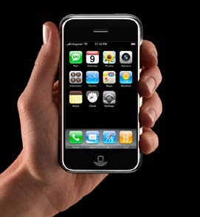
In GUI Design Aesthetics is about
Sensory + Empirical + Taste + Judgment
The Philosophical argument of aesthetics shown below is incorporated into Interfaces through Graphic designing
Simplicity + Infinity + Eternity + Serenity = Beauty
Aesthetics is both Art as well as Mathematics.
It is both rational as well as emotional at the same time.

Slide 5
Aesthetics is a medium for User Experience
Appearance Visual Quality
2
Appearance Visual Quality
Technology Build Quality
DESIGN
3
Interaction Use Quality
1
Aesthetics (Look & Feel) + Communication + Use ability
= Total UI Experience

Slide 6
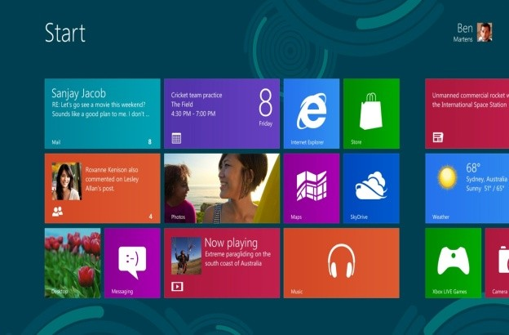
Role of Aesthetics –
often misunderstood & underestimated
Aesthetics is not mere beautification.
It has as much to do with FUNCTION as with beauty
Aesthetics is not the surface characteristics of a GUI It is not decoration. It is not cosmetic
A ‘good looking’ GUI needs also to function
to communicate to express
to instruct to perform

Slide 7
While the judgment of Aesthetics is subjective the construction / configuration is not.
There are elements & principles of good aesthetic configuration
ELEMENTS
Line, Shape, Space, Color, Form, Texture, Light
PRINCIPLES
Balance, Emphasis, Rhythm, Unity, Contrast, Movement

Slide 8

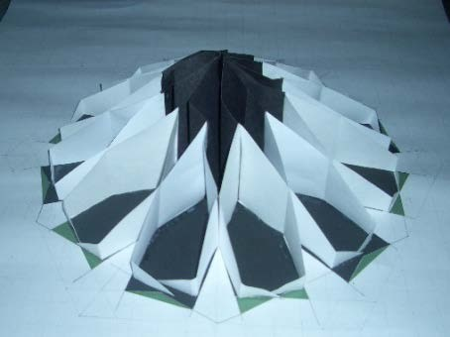
Principles of design in Visuals
Design is composed of manipulating the physical characteristics of size, shape, texture, proportion, scale, mass and color.
Order & composition is the arrangement and organization of elements in relation to each other.
Form follows function is a design approach wherein the form (overall layout / composition/geometric shape) of a GUI is determined by what function it does.
Ex: An arrow has a Form having a sharp angular face at one end expressing the function of pointing to a direction.
Composition
An orderly arrangement of elements using the principles of design

Slide 9
Principles of Design
Grammar of the visual language.
Rules for composing with the elements
The Principles of Design can be thought of as what we do with the elements of design to express and communicate a predetermined message
of Usability, Reliability, & Functionality in a harmonious fashion.
Balance
Unity
Proportion
Harmony
Direction
Rhythm
Symmetry
Pattern
Emphasis
Contrast
Movement
Notice that many of the terms on the right figure are also used in Mathematics.
Design, therefore has both, Aesthetics and Mathematics, underlying it.

Slide 10
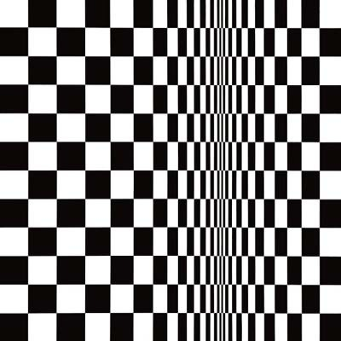
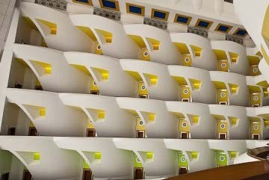
Description of some of the Principles
Rhythm & Movement
Movement is the path the viewers eye takes through the artwork, often to focal areas. Animation is often used.
Rhythm is created when one or more elements of design are used repeatedly to create a feeling of organized movement / direction.

Slide 11



Emphasis
This is the part of the design that catches the viewer’s attention. Usually the Designer will make one area stand out by using the elements of design in a contrasting way. There will be a play with different sizes, colors, textures, shapes etc.
Contrast
Differences and Diversities.
Highlighting similarities
High contrast
Low contrast

Slide 12
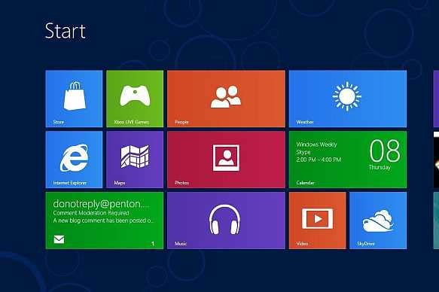
Unity
Unity is an overall “sameness” throughout a screen.. How harmoniously all the elements blend together.
Example: Windows 8 GUI
.
Balance
Visual balance. Are the various elements visually balanced in terms of their Size, shape, weight, and placement. Can the rhythmic order be visually discernable ?
1.618
Proportion
Size relationships found within an object or design. Also a comparison in terms of ratio of size, shape, etc with neighboring elements.
Example see proportions of various buttons within Windows 8 screen
The Golden Rectangle ratio
1: 1.618
1

Slide 13
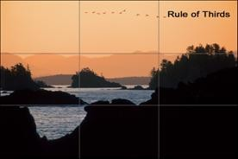
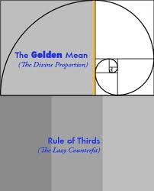
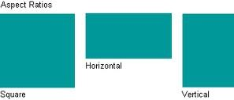
Proportion & Rule of thirds division of a screen
Proportion refers to the size relationship of visual elements to each other and to the whole picture. One of the reasons proportion is often considered important in composition is that viewers respond to it emotionally.

Slide 14

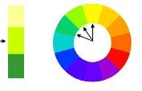
COLOUR
Colour is a vast subject of both Physics and Fine Arts.
Graphic Designers use metrics to specify colours.
Hue: refers to the names of the primary colours. (red, green and blue).
Value: lightness and darkness of the hue –
Shade: amount of white or black added.
Intensity: the purity or saturation of the colour
Monochromatic : use of one colour where only the value of the colour changes
Analogous colours: colours that are adjacent to each other on the colour wheel,
e.g. yellow and green are analogous.
Limitations of Technology
The Visible spectrum consists of billions of colours, a computer monitor can display millions, a high quality printer is only capable of producing thousands, and older computer systems may be limited to 216 cross-platform colours.

Slide 15
The Psychology of Colours
COOL colours include: violet, blue and green because of our association with sky, water.

Slide 16
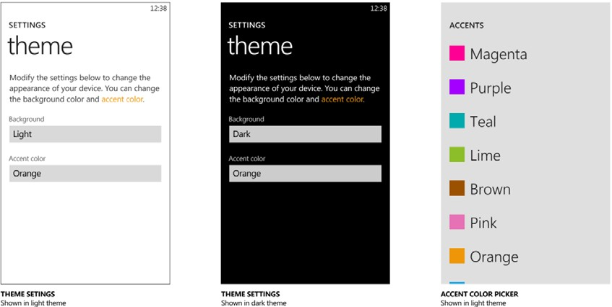
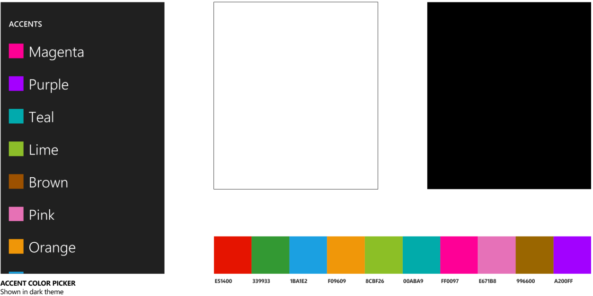
Colour Theme
Choices of colour given to the User. Simple Pick & Chose does not confuse the user with 100s of colours to chose from.
A set of colours are carefully decided upon by a designer which form a ‘ theme’ .
All screens will have visual elements from the theme.

Slide 17
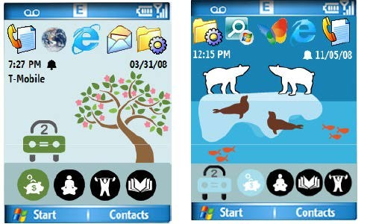
Graphic Design Principles: Example: mobile screen
The Clustering Principle:
Organizing the screen into visually separate blocks of similar controls, preferably with a title for each block. Modern WIMP (Windows-Icons-Menus- Pointer) systems are a natural expression of the Clustering Principle
Cluster 1
Grid lines
Cluster 2
Information on a screen which is not catagorised into some order ( right hand screen in the above figure) can be confusing. GRIDS are therefore used to not only to align & please aesthetically but also catagorise UI elements according to functions .

Slide 18
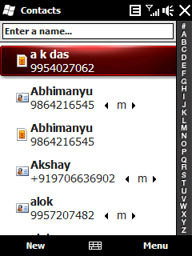
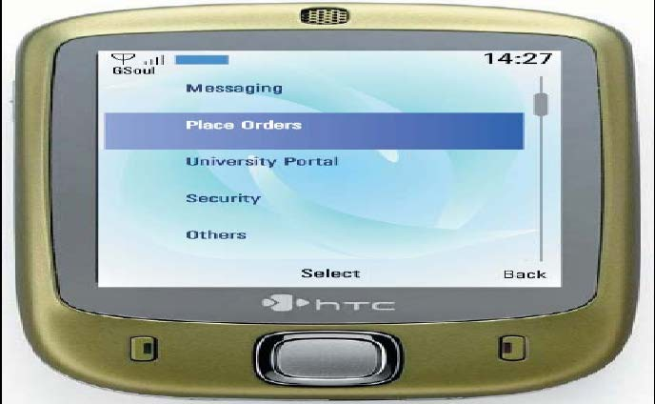
Type size and font, for example: the
Reduced Clutter Principle would suggest that one or two type styles are sufficient.
Poor Font readability

Slide 19
Avoid fancy fonts totally
Safe Fonts
Arial, Helvetica, sans-serif
Courier New, Courier, mono
Verdana, Arial, Helvetica, sans-serif
Geneva, Arial, Helvetica, sans-serif
Regional Fonts still have unresolved problems when used in low resolution & small displays screens.
ಜನ�ೕ ಜನ�ಭೂ�ಶ� ಸ��ಾ�ದ� ಗ�ೕಯ�ೕ जननी जन्मभ�ू मश्च स्वगार्द�प गर�यसी ஜநந� ஜந்ம�மிஶ்ச ஸ்வர்காதப� க�ய�
ಜನ�ೕ ಜನ�ಭೂ�ಶ� ಸ��ಾ�ದ� ಗ�ೕಯ�ೕ
जननी जन्मभ�ू मश्च स्वगार्द�प गर�यसी ஜநந� ஜந்ம�மிஶ்ச ஸ்வர்காதப� க�ய�
జన� జన్మభ��శ్చ స్వ�గ్ాద�ి గ�య� �ీ
ജനനീ ജന്മഭൂമിശ്ച സ�ര്ഗാദപി ഗരീയസീ જનની જન્મ�િૂમ� સ્વગાર્દિપ ગર�યસી ਜਨਨੀ ਜਨ੍ਮਭੂਿਮਸ਼� ਸ�ਰ�ਾਦਿਪ ਗਰੀਯਸੀ
Weight of font matters
BOLD – some times , results in poor smudged readability on mobile screens - even on AMOLED

Slide 20
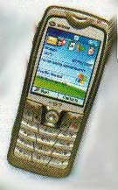
Screen resolution & aesthetics
Caption bar | 26 pixels
Address bar | 23 pixels
Content 229 X 255 pixels
Scroll bar | 11 pixels
Menu bar 26 pixels
25 to 30% of the area is taken by buttons, etc.
Therefore only about 229 X 255 is effectively available from a 320 X240
display.

Slide 21
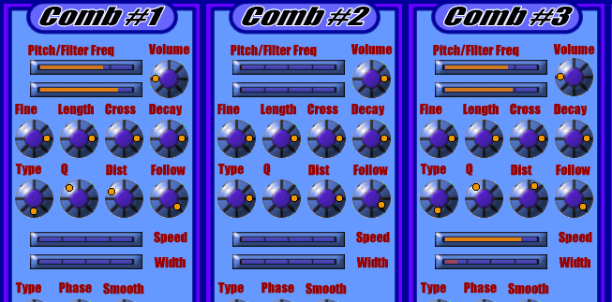

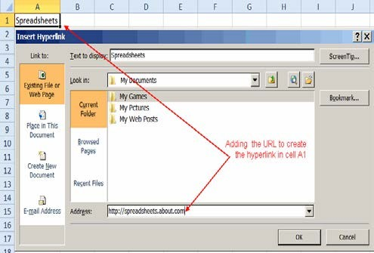
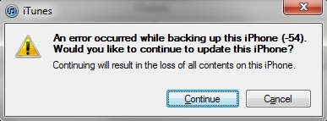
Some unsatisfactory GUIs.
Too many similar elements. No colour contrast.
Monochrome colour scheme is visually too heavy. No differentiation . No identity.
Functional confusion. Poor communication.
Difficult to use. Error prone.
No colour contrast. Too many data fields undistinguishable.
Use of same colour (orange) to for two different tasks.
Icon to depict ‘ security’ has two humans . Not representational & meaningful.
Confused verbal statement label. The two buttons offer a dead end. By executing the action the user is not visually informed as to what to do.

Slide 22

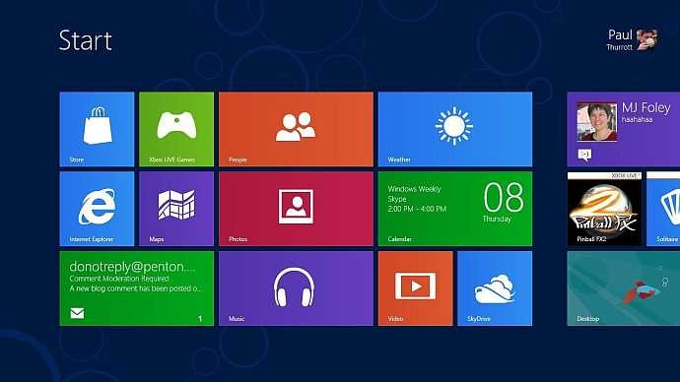
Case Study 1 : Windows GUI
Aesthetic and minimalist design:
The system is not cluttered with excessive use of icons and buttons. Tabs are used to separate different functionalities. A simple rectangle composition arrangement is used to model information.
Recognition rather than recall: The use of colour schemes and icons act to denote functionalities . Example ‘ Head Phone icon”. This design feature promotes recognition of rather than recall of system functionalities

Slide 23


Case Study 2 : Icon Design
Two simple icons communicating an activity in progress.
Both the icons are graphically simple, do the function of informing the status & are not complicated to understand.
They use gradient in colorus (monochrome) to depict time progress through animation. The circular form express the abstract concept of time.
The state of ‘please wait’ is expressed in a pleasant peaceful unhurried manner.
In terms of construction, the icons do not take expensive screen real estate; need very less computing memory; are amiable to both pixel as well as vector graphics.
The icon has achieved this by employing aesthetic principles in their form, colour, shape, configuration, motion & composition – all of them put together holistically resulting in a simple ‘design’.

Slide 24
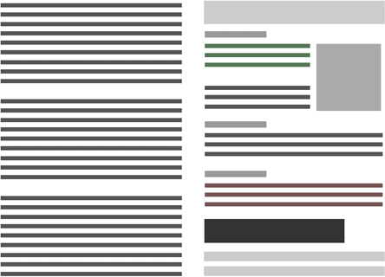
Graphic Design – Website Layout
HCI-Designers besides being Engineers are Artists in the sense that they have to become sensitive to the visual language and master the use of visual elements in accordance to Principles
Too much of order. Not Interesting
Rhythmic spacing. Different shapes create interesting lay out.

Slide 25


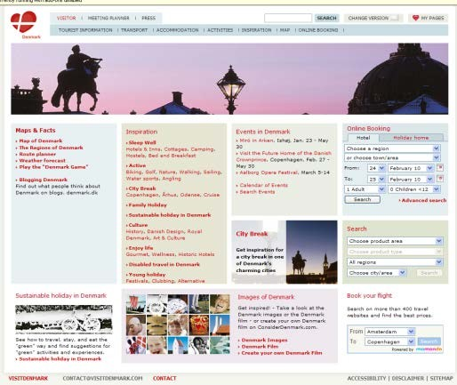
Graphic Design Case Study 3
A case study of a website’s visual quality
The principles of Cognitive Science – Gestalt laws govern aesthetics.
Visual balance, Hierarchy
Aesthetics Ordered Grid - Rows and Columns
Good composition –
Position with respect to area
Visual Balance – Symmetry / Asymmetry Low visual noise –
No clutter or crowding
Color & Graphics –
The U I -interface of a product is not a canvas for
art nor a surface for advertising.
Simple plain light reflective /absorbing colors with no fancy labels.

Slide 26
Aesthetics is a specilised discipline.
It has as much science & technology in it as much as Art.
It is qualitative as well as quantitative judgment.
Creative Designers are best equipped to decide on aesthetics as they are trained professionally.

Slide 27
Assignment 1
From any computer or mobile screen pick one GUI which you do not like & one more GUI which you like.
Analyze their constituting graphic / visual elements by applying principles of aesthetics and find out if you can attribute any aesthetic reasons for your ‘like’ & ‘dislike’. Keep functional & usability aspects out of the judgment for the time being.

